Slide 1


Chronic disease and work
Dr Angela de Boer
Coronel Institute of Occupational Health, AMC
PI Chronic disease and work
25-11-2016

Slide 2

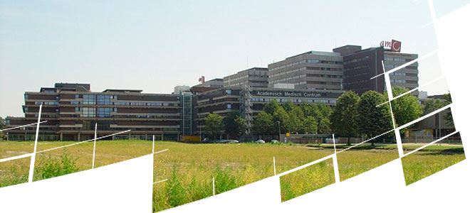
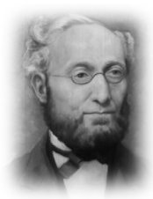
Coronel institute of occupational health, AMC
  70 Colleagues
  Disease Work
  Work Disease

Slide 3
Overview
Getting insight in the work participation of employees with a chronic disease and its societal impact
Identifying factors which are associated with return to work and work participation
Interventions to support work participation in employees with a chronic disease
Statements

Slide 4
Patients of working age with a chronic disease and their work participation

Slide 5

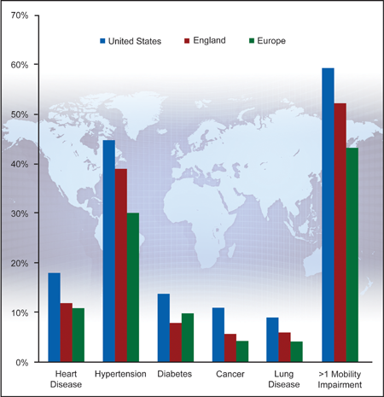
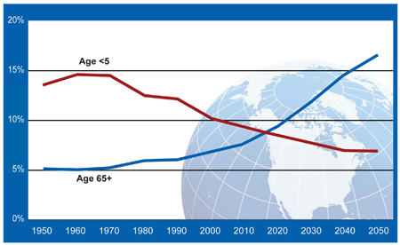
Prevalence of chronic disease
Prevalence of Chronic Disease and Disability among Men and Women Aged 50-74 Years in the United States, England, and Europe.
Source: WHO

Slide 6
Increase of workers with chronic disease
  Increase of patients of working age with a chronic disease
  Better treatment and higher survival rates
  Ageing (working) population
  Higher pension age
  In the Netherlands 5.3 million people of working age with a chronic disease or impairment (32%)
  Expectation in 2030: 7 million people
  Societal participation becoming more important
Nationaal Kompas, EUROSTAT

Slide 7
Workers with a chronic condition in NL
Nationale Enquête Arbeidsomstandigheden, TNO/CBS, 2015

Slide 8

Chronic disease and return to work
Return to work and staying at work regarded as a rewarding experience by patients themselves
  Higher quality of life
  Income and Insurance
  Back to normal
  Structure and social contacts
  More active and healthy life style
Cancelliere 2016; Callander 2013; Boot 2016

Slide 9

Employment and chronic disease
Working with a chronic disease is also regarded as difficult
  Working people with chronic diseases report¹
Significantly reduced work productivity
Living with less income
Having poor mental health
People of working age with a chronic disease have:
Higher chance of unemployment:
74% of people with a chronic disease are not employed, versus
34% of people without ²
  Higher chance of disability pension
  Especially for young adults with long-standing (childhood) disease
¹ K.Lorig, Stanford; ² NIVEL 2015;

Slide 10




Chronic disease and return to work
  Cancer:
      Average return to work rate: 64 % after 18 months ¹
      Cancer survivors: 37% higher chance of unemployment ²
    Heart failure:
      Average return to work rate: 68% after 12 months³
      24% are not working at pre-heart failure levels⁴
    Inflammatory bowel disease:
      23% receive disability pension⁵
      78% of the workers experience work difficulties⁵
    Acquired brain injury:
      Average return to work rate: 40% after 24 months⁶
      ¹ Mehnert 2013; ² De Boer et al. JAMA 2009; ³ Roth 2016; ⁴Slebus 2012; ⁵de Boer 2016; ⁶van Velzen 2016

Slide 11
Summary
  Increasing numbers employees with a chronic disease
  Employment is important for people
  However, more likely to be unemployed or receive a disability pension

Slide 12
What influences return to work and work participation in employees with a chronic disease?

Slide 13

Factors associated with work participation
Younger age
Male gender
Higher education
Fewer physical complaints
Higher work ability
Cancelliere 2016; Vooijs 2015; Donker-Cools 2015; Detaille 2009; Dekkers-Sanchez 2008; de Boer 2008

Slide 14


Fatigue
Prevalent problem in many chronic diseases: cancer, heart failure, IBD, rheumatic disease, diabetes
Long-term > 5-years
Strong predictor of prolonged sick leave duration and unemployment
Patients say:
  “I was too tired because of heart disease and stopped working”
  “I work 20 hours divided over the whole week. I sleep in the afternoon”
Cancelliere 2016, van Vlisteren 2016, van Velzen 2016, Slebus 2012, de Boer 2008; van Muijen 2016..

Slide 15

Cognitive impairments
Problems with:
  Attention
  Speed of information processing
  Verbal and visual memory
  Multitasking
Cognitive impairments associated with unemployment
In patients with:
- Cancer (chemobrain) ¹
- Acquired brain injury ²
- Heart disease ³
- MS ⁴
¹ Nieuwenhuijsen 2009; ²van Velzen 2015 ; ³Ghanbari 2013; ⁴van der Hiele 2014

Slide 16
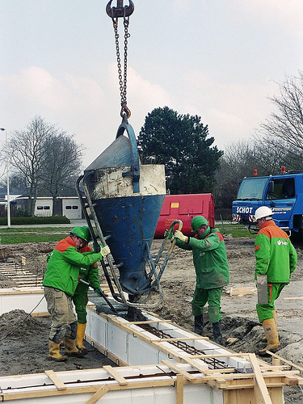
Workplace
Adjusted work conditions enhance RTW
Heavy work associated with higher unemployment risk
Employers play a key role to create good work conditions
Vooijs 2015; de Boer 2008; Kristman 2016

Slide 17
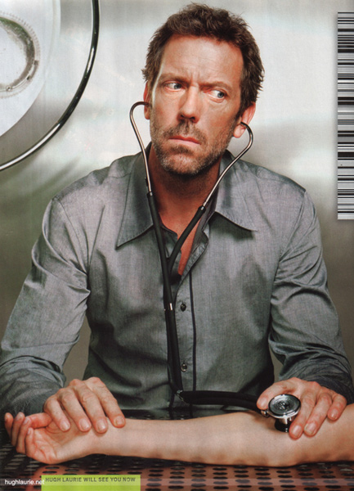
Doctors: knowledge and communication
Treating doctors feel ill-equipped to address occupational issues of their patients ¹
However, they have contact early in the treatment process and their patients raise work issues ¹
GPs are becoming increasingly important ²
Involvement of treating doctors in work issues does improve return to work ³
¹ Morrison 2015; ²de Kock 2016; ³Verbeek 2003

Slide 18
Summary
  Several person-related and disease-related factors influence return to work and length of sick leave
  Attention needed for:
  Fatigue
  Cognitive impairments
  The role of the workplace
  The role of doctors

Slide 19
Chronic disease and work participation:
Interventions to help employees with a chronic disease

Slide 20

Interventions: reviews
Important to provide employees with a chronic disease with programs to support their return-to-work
Systematic (Cochrane) reviews:
  Cancer ¹
  Brain injury ^{2 ,3}
  Multiple sclerosis ⁴
  Back, neck, shoulder pain ⁵
Multidisciplinary interventions led to higher return-to-work rates than care as usual
¹ de Boer 2015; ²Turner-Stokes 2015 ; ³Donker-Cools 2016; ⁴Khan 2019; ⁵ Schaafsma 2013;
Notes:
20

Slide 21

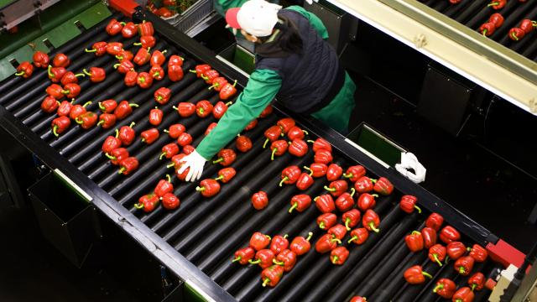


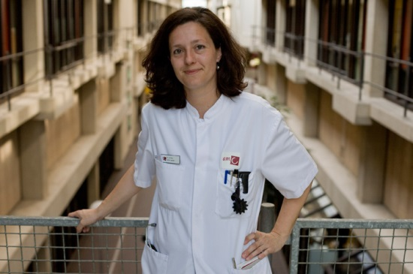

Multidisciplinary
  Multidisciplinary interventions: a combination of psychological, vocational, and /or physical interventions

Slide 22


Interventions enhancing work participation
Disease generic interventions aimed at the workplace
Workers with a chronic disease
Effective interventions provide ¹ :
  Adaptations in work including equipment, working times, transportation ^{2, 3,4}
  Case management worker and employer, early contact with work place ^{2 ,3}
  Contact with work place by (health care) professional ²
¹ Vooijs 2015; ²van Oostrom 2009; ³ Franche 2005; ⁴ Nevala 2015

Slide 23
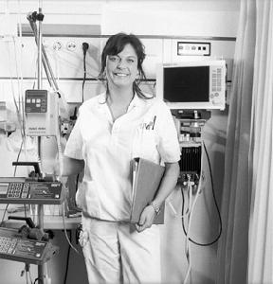
1. Hospital-based work support: cancer
Content
4 appointments with an oncological nurse of ± 15 minutes each
  To guide patients to return to work
  Occupational training for nurse
1 brainstorm session with supervisor, occupational
physician, and patient
Letter from the treating physician to OP
Tamminga, 2013

Slide 24

1. Results
Main results (RCT)
N=133 female patients mainly with breast cancer
Primary outcome partial return to work
86% (intervention group) versus 82% (control group)
Relative risk: 1.03 (95% BI 0.84-1.2) , no significant effect
Easily accepted in usual care
Barriers
Communication between OP and treating physician hard to improve
Not tailored: same intervention for all patients
Vulnerable groups not included
Tamminga, 2013

Slide 25

2. Cancer survivors with work loss
Cancer survivors without a job
Tailored return to work program
Developed in cooperation with Dutch Social Security Agency (SSA) and a national re-integration agency
Participants, together with a RTW coach, decide which needs should be addressed to RTW
Content:
  Developing his/her consensus-based tailored RTW plan
  Receive coaching on identifying obstacles or RTW
  Exploring possibilities for (therapeutic) return to an actual workplace
Van Egmond, 2015

Slide 26
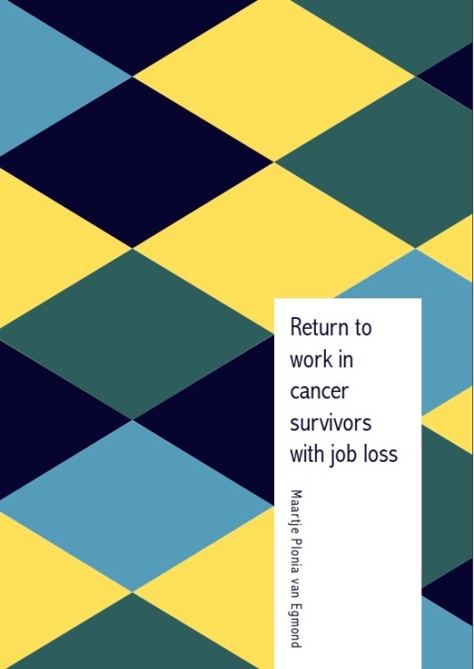
2. Results
Main results (RCT)
N=171 patients mainly with breast cancer
Primary outcome return to work (get a job)
25% (intervention group) versus 21% (control group)
Hazard ratio 0.86 (95% CI 0.46–1.62), no significant effect
Barriers
Less than half of the participants in the intervention group received program according to protocol
Only 6% of the invited CSs eventually participated
Vulnerable groups difficult to include ?
Van Egmond, 2016

Slide 27
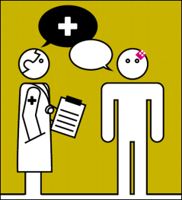

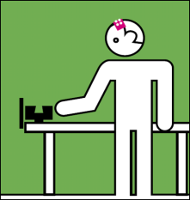
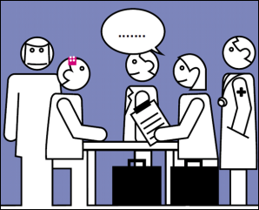
3. Early vocational rehabilitation
Patients with acquired brain injuries
Content:
  Stage 1: Orientation on work
  Intake treating physician and vocational specialist
  Stage 2: Investigating the gap between patients’ abilities and work
  Stage 3: Work training
  Patient
  Stage 4: Finalising Early Vocational Rehabilitation
  patient, employer and occupational physician
Van Velzen, 2016

Slide 28
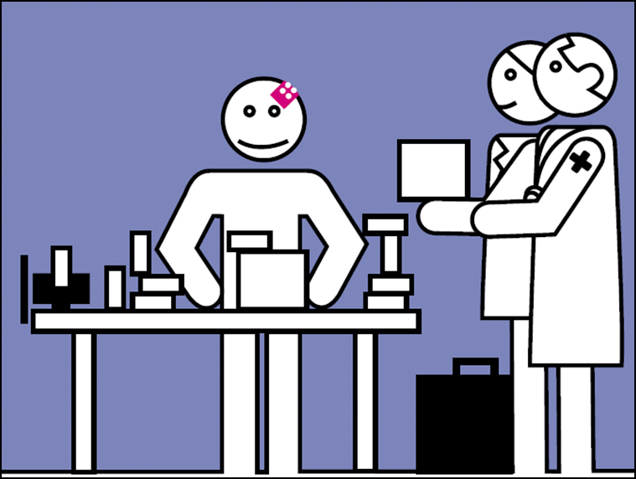
3. Results
Main results (Feasibility study)
N=23 patients
Feasible
Structured protocol used
Information provided
80-90% RTW within 12 months
Barriers
Not enough time, not enough contacts
Connection between work requirements and work training should be improved
Difficult to implement in usual care
Van Velzen, 2016

Slide 29

4. Workers with Rheumatoid Arthritis
Patients with rheumatoid arthritis, with a job
Having work difficulties
Integrated care:
  Multidisciplinary team with occupational physician, occupational therapist, patient’s own rheumatologist
  Treatment plan based on active participation
Workplace intervention:
  Consensus between patient and supervisor regarding feasible solutions for obstacles for functioning at work
Van Vlisteren, 2016

Slide 30

4. Results
Main results (RCT)
N=150 patients rheumatoid arthritis
Primary outcome at-work productivity loss in hours per week
No change (intervention group) versus 0.1h less loss (control group)
B: 0.24 (95 % CI −0.43 to 0.90), no significant effect
Improvement of supervisor support
Barriers
Relatively mild degree of limitations in work functioning
Vulnerable groups not included ?
Van Vlisteren, 2016

Slide 31
Summary
  Multidisciplinary interventions have shown to effective in enhancing return-to-work in reviews
  Difficult to include vulnerable groups in interventions, but they might need it most
  Difficult to include the workplace in interventions and the role of employer needs more attention
  Communication between stake holders needs to be enhanced and health care providers should be included in return-to-work issues

Slide 32
Conclusion
  Number of workers with a chronic disease is increasing
  Return to work can be difficult
  Multidisciplinary interventions to support RTW can be effective
  Need for inclusion of multiple stake holders including health care providers and employers
  Need for inclusion of
  vulnerable groups

Slide 33
Thank you!
a.g.deboer@amc.nl

Slide 34
Statements
  “One size fits all” excludes vulnerable groups in interventions aiming at RTW for workers with a chronic disease.
  Selection of vulnerable workers with a chronic disease eligible for interventions is inevitable.
  “Work” has to be an essential part of clinical care.
  Work is essential for everybody.
  Disease-generic interventions are sufficient and disease-specific interventions are unnecessary.

